Slide 1
Detection of Electricity Charging Fraud
Data Management Plan

Slide 2
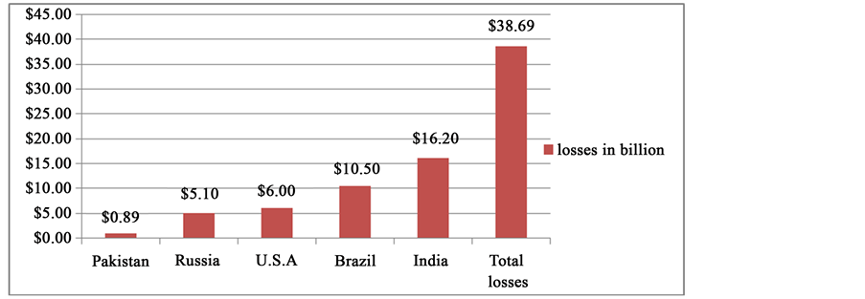
Problem Statement:
Electricity companies are incurring losses from fraudulent electricity subscribers
Risk of electricity fraud on national income

Slide 3
Project Goal:
Provide indicators and insights to detect Electricity fraudulent Subscribers
Long-term project
Target Project:
Provide a dashboard for electricity companies which can integrate their systems to our dashboard through API to get results and clusters about most likely fraud users to be checked and labeled.
Increase a warning in fraud villages and notification for employees in electricity comapnies

Slide 4
Types of Data Collected:
- Historical non-labeled data
- Charging transactions for a period of four years from three villages (3 data sets) – 941,621 transaction
Quantitative and qualitative variables, such as (charging amount , charging date, charging price … etc.)
No personal data included in the data set
In the future, the characteristics of fraudulent subscriber should be obtained from various electricity companies

Slide 5
Collection of Data in the Future:
Data will be uploaded to our model by the end users (electricity companies)
In long run , API may connect our model with electricity company charging system
Additional data variables will be obtained to strength our system (subscriber family members, subscriber job … etc)
Data should be transferred to be labeled data in coordination with electricity companies

Slide 6
Data Privacy, Storage, Security and BackUp:
Confidentiality agreement will be signed with electricity companies
The data collected should be anonymous regard the subscriber’s names/ personal ID’s
The data should be encrypted
General security measures will be taken
Back up policy will be developed

Slide 7
Project Questions:
What are the interruptions in charging for each subscriber?
2. Is there any abnormal increase/decrease above or below subscriber average consumption ?
3. Are there any relations between regions and average consumption?
4. Are there any relations between the subscriber's job (government, worker, official) and his electricity consumption?
5. Are there any relations between the type of subscription (municipal employee, household, 3-Vaz,..) and its consumption of electricity?
6. Are there any relations between the electricity providing types (normal, industrial) and electricity consumption among subscribers?
7. Are there any relations between the type of property (apartment, building, workshop, detached house,..) and its electricity consumption?
8. Are there any relations between temperature on consumption?
9. Is there any charging prices/KW different from the main rates specified for each subscriber category ?

Slide 8
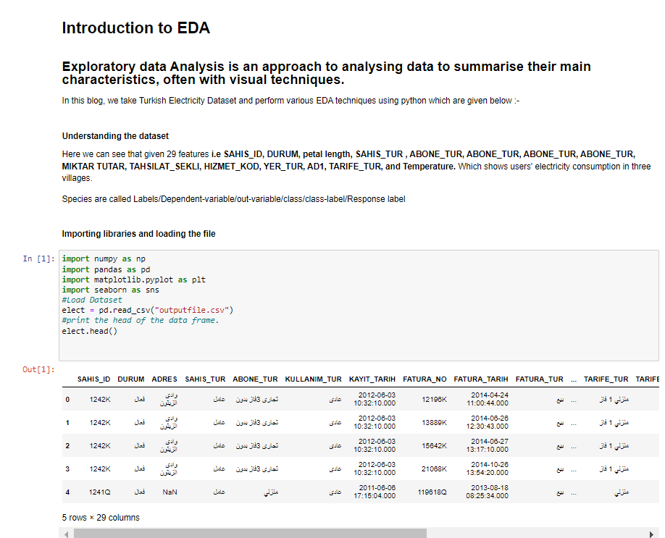
EDA

Slide 9
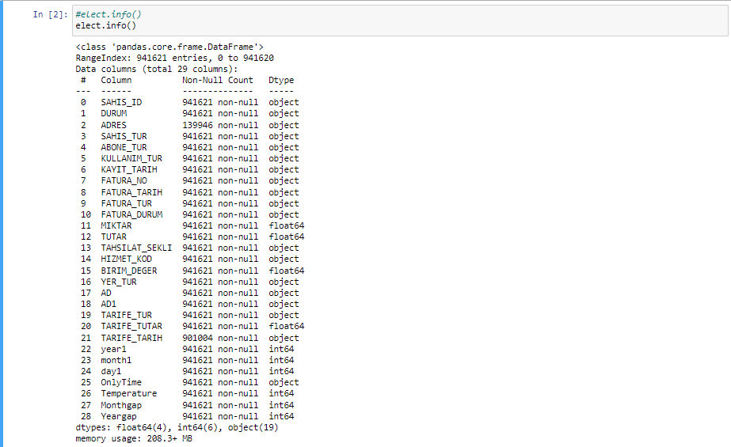
EDA

Slide 10
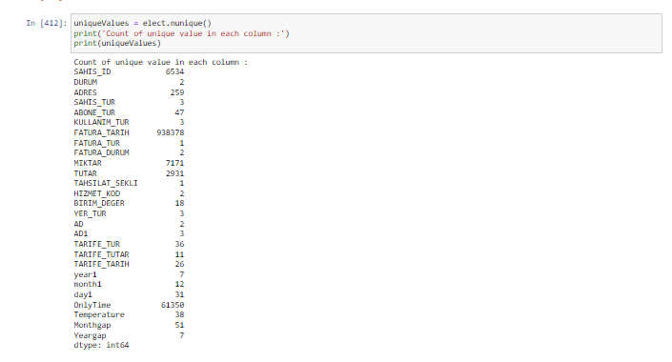
EDA

Slide 11
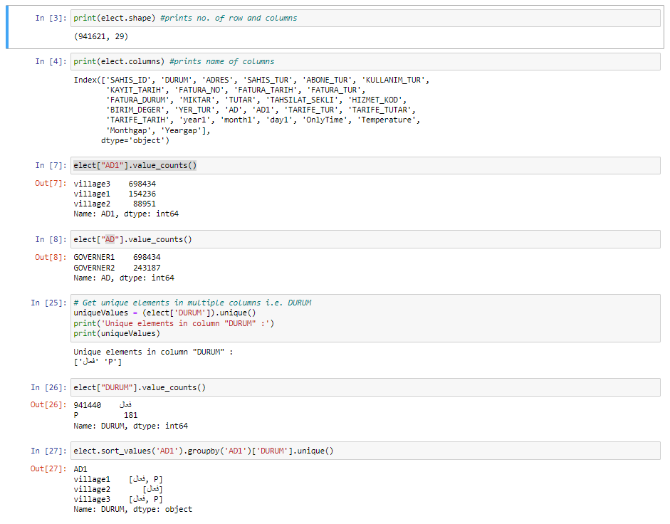
EDA

Slide 12
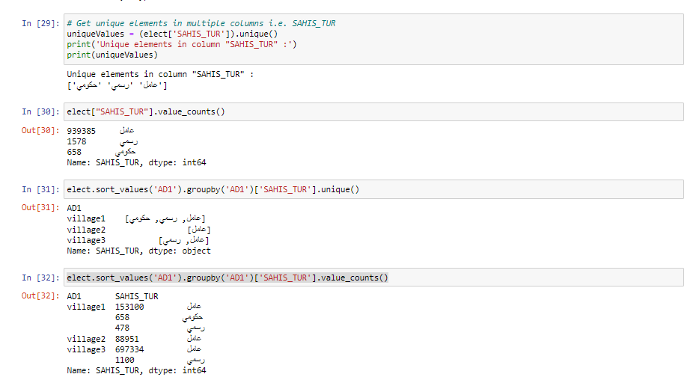
EDA

Slide 13
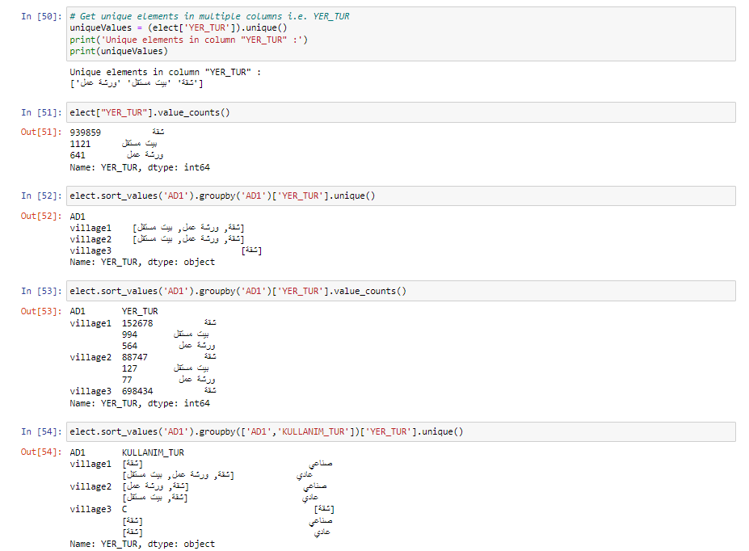
EDA

Slide 14
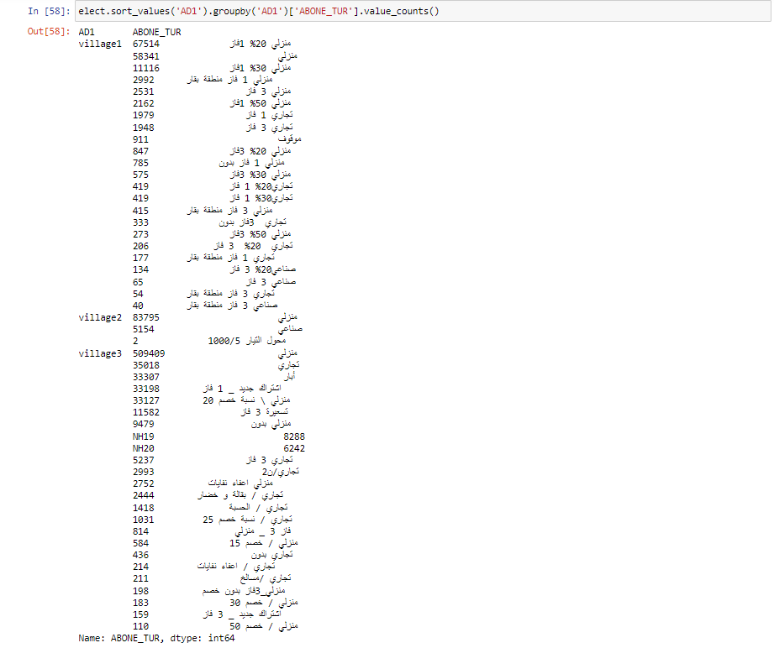
EDA

Slide 15
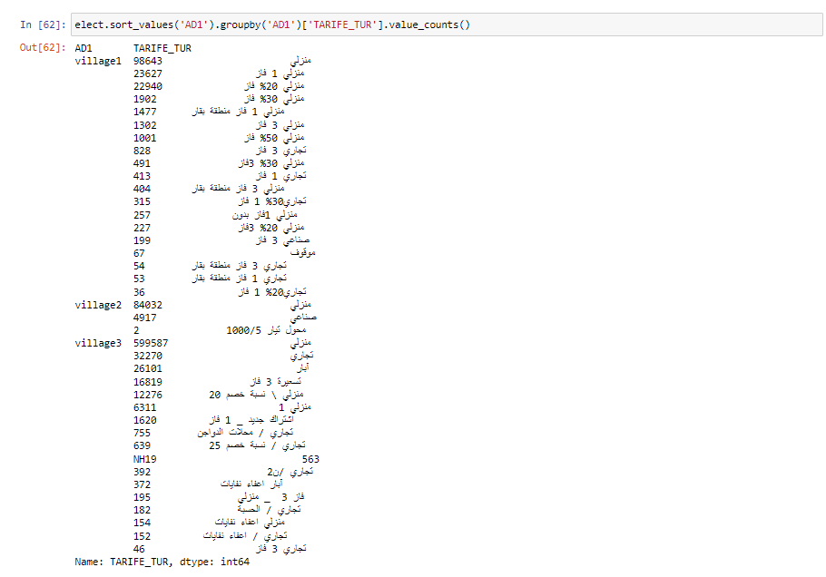
EDA

Slide 16
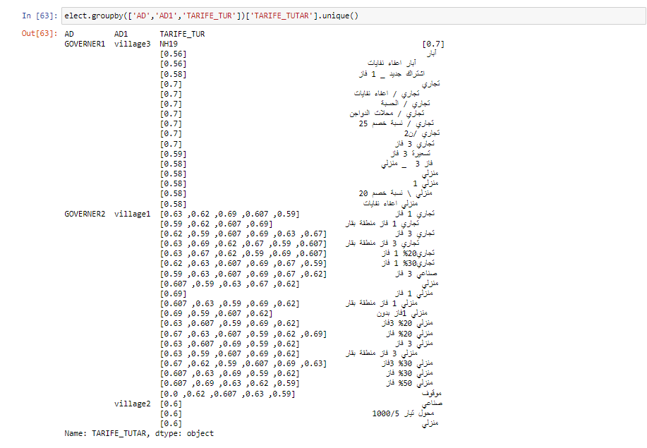
EDA

Slide 17
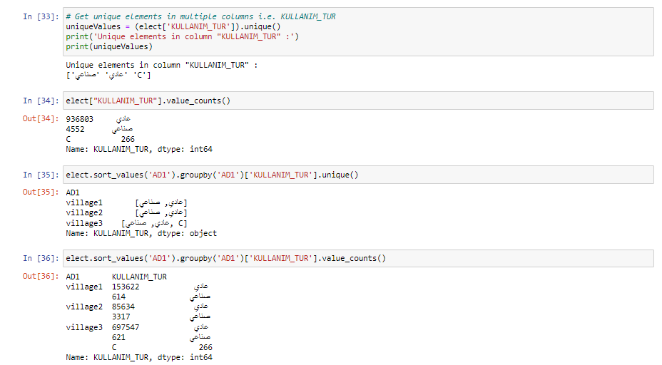
EDA

Slide 18
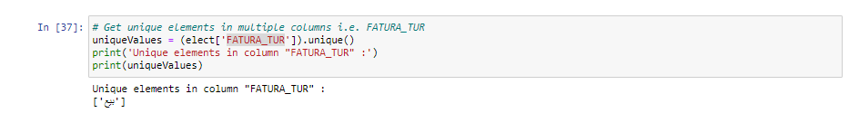
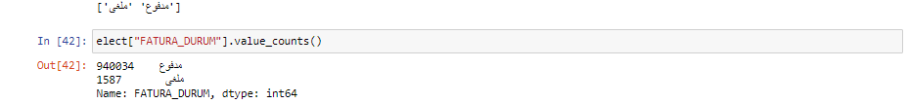
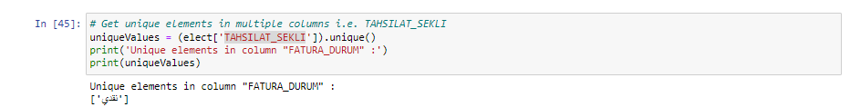
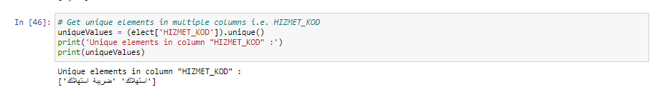
EDA

Slide 19
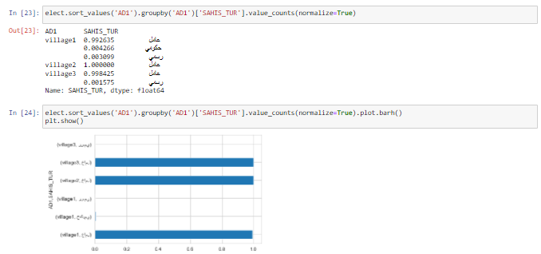
EDA

Slide 20
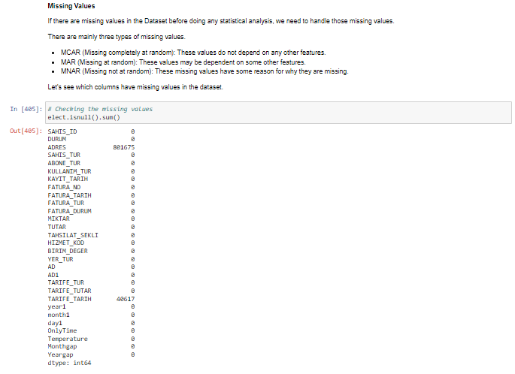
EDA

Slide 21
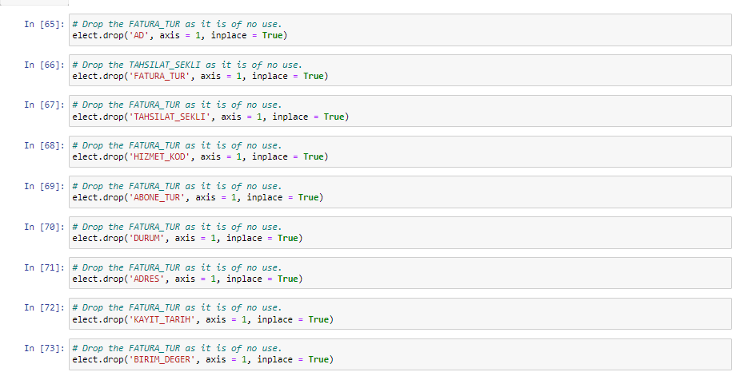
EDA

Slide 22
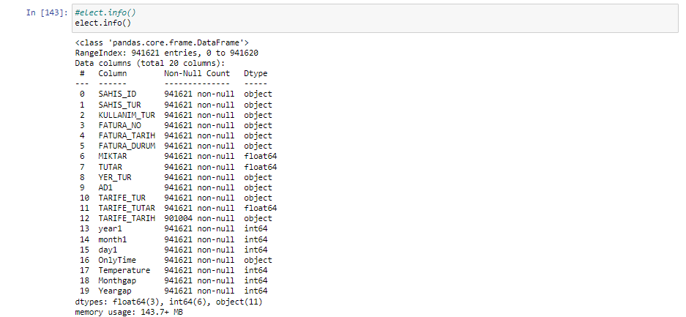
EDA

Slide 23
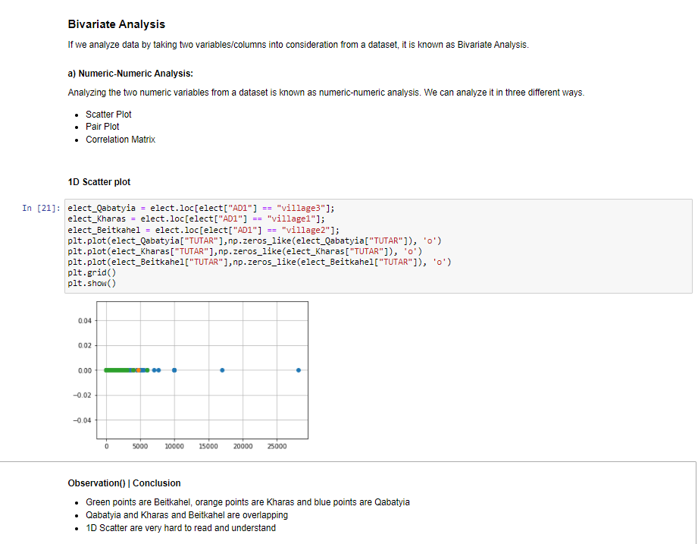
EDA

Slide 24
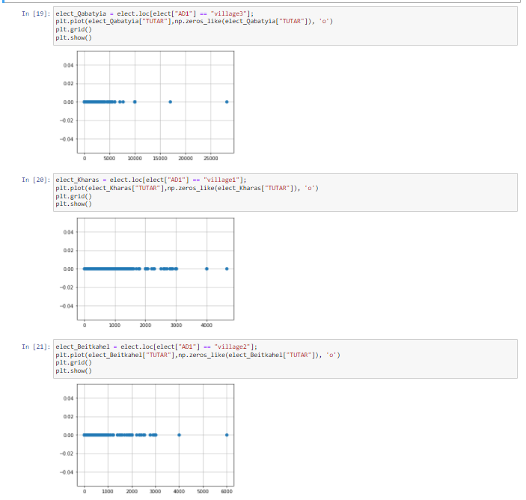
EDA

Slide 25
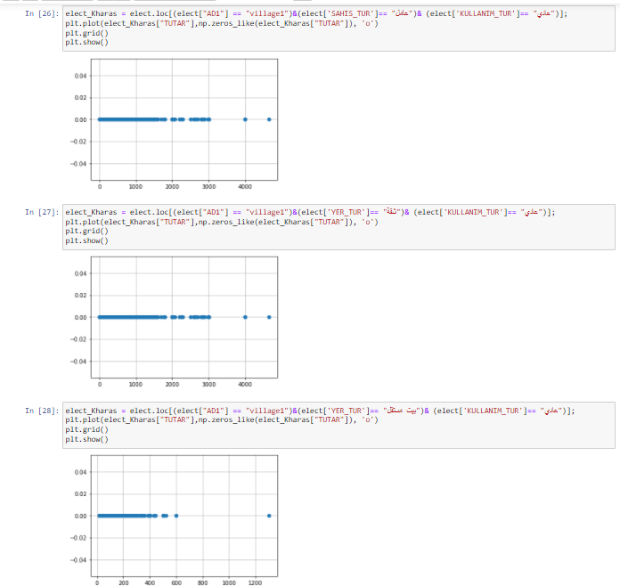
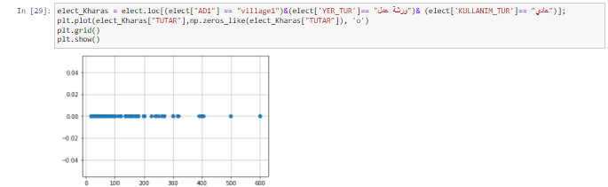
EDA

Slide 26
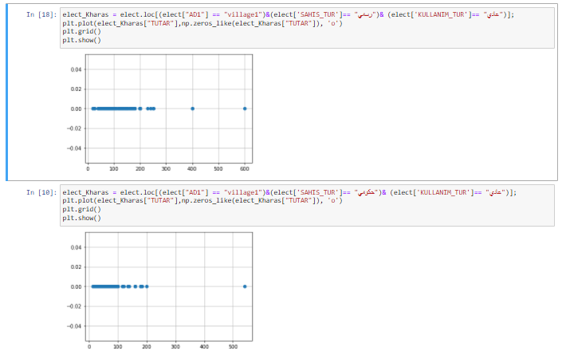
EDA

Slide 27
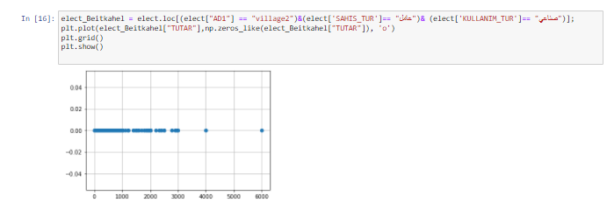
EDA

Slide 28
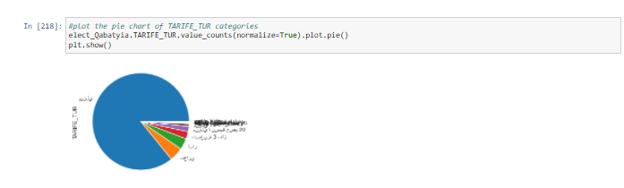
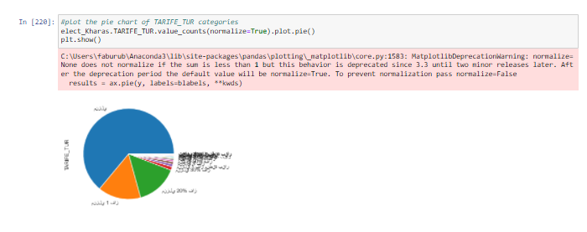
EDA

Slide 29
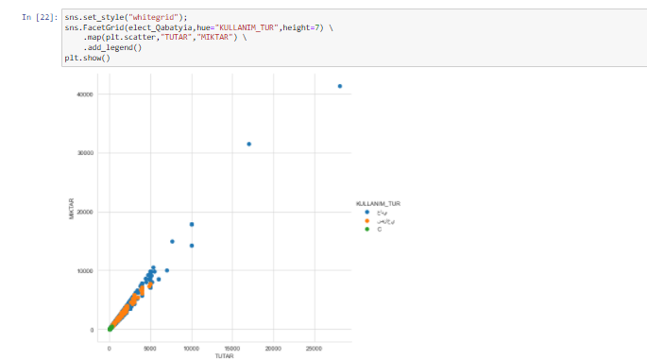
EDA

Slide 30
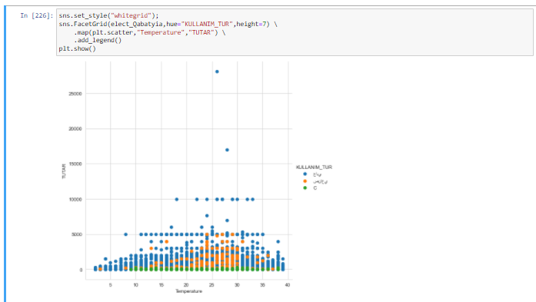
EDA

Slide 31
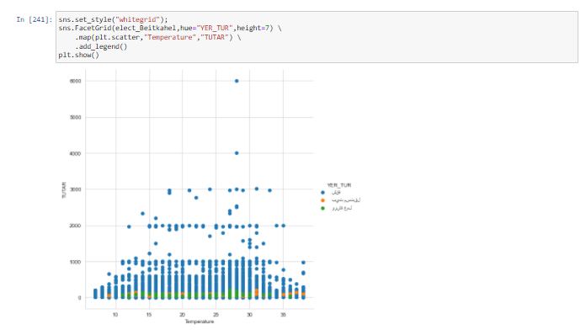
EDA

Slide 32
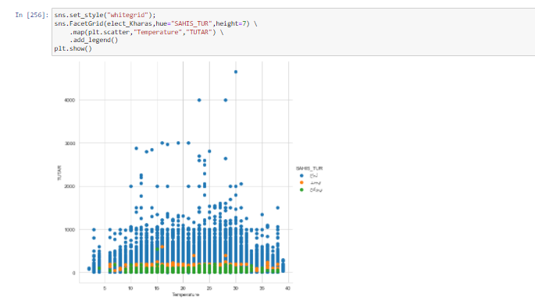
EDA

Slide 33
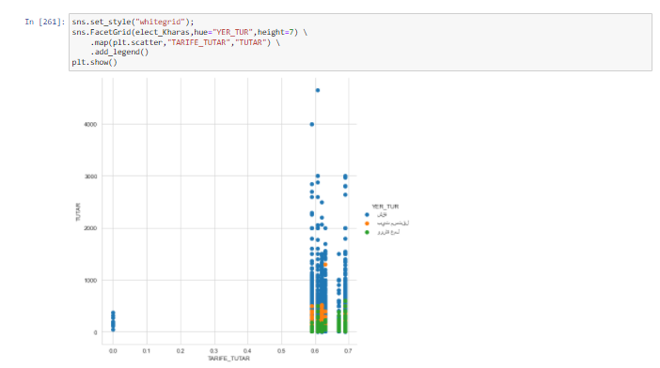
EDA

Slide 34
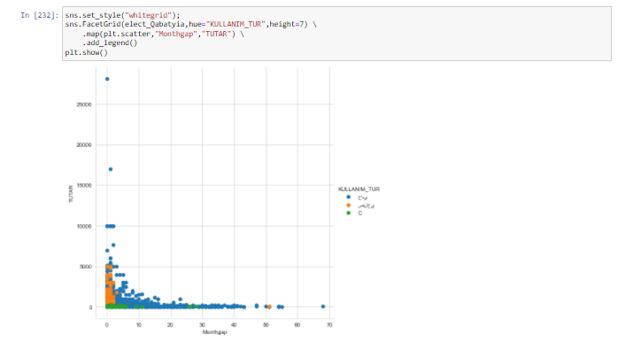
EDA

Slide 35
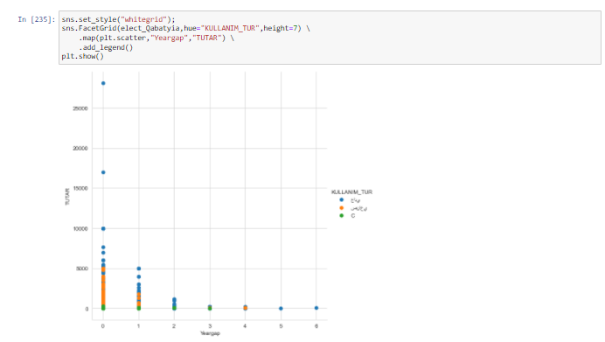
EDA

Slide 36
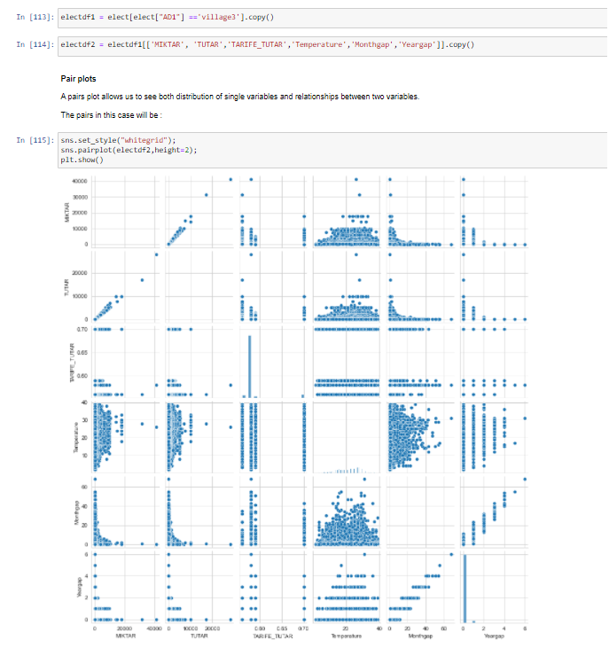
EDA

Slide 37
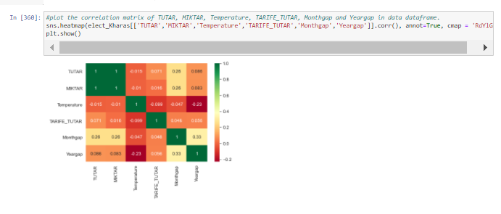
EDA

Slide 38
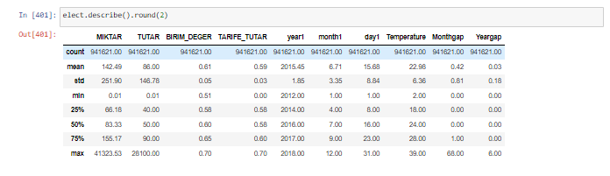
EDA
75% 100 or low shekel normal
25% outlier < 40 and > 200 needed to be tested and we will take top 100

Slide 39
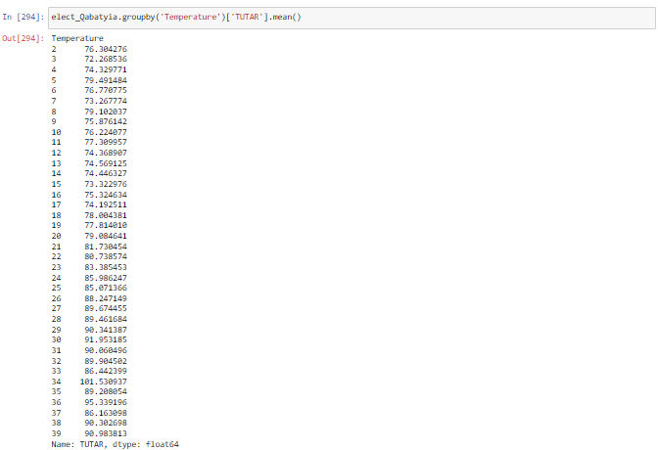
EDA

Slide 40
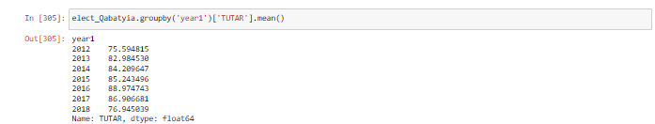
EDA

Slide 41
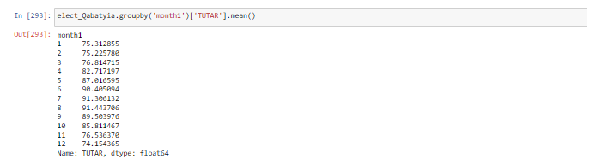
EDA

Slide 42
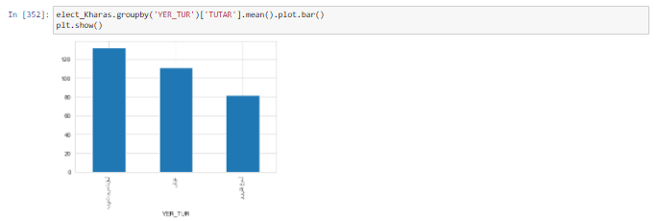
EDA

Slide 43
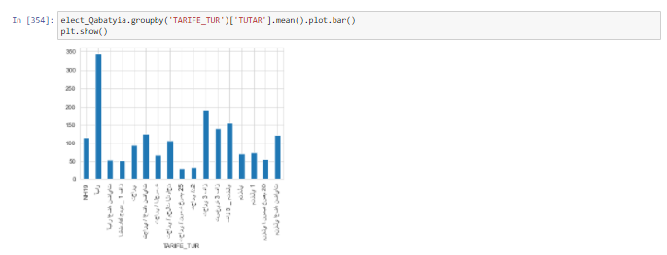
EDA

Slide 44
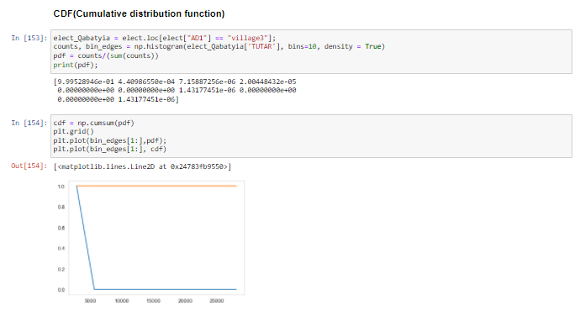
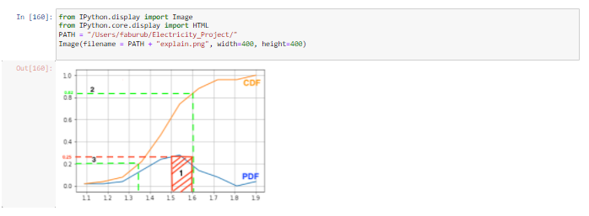
EDA

Slide 45
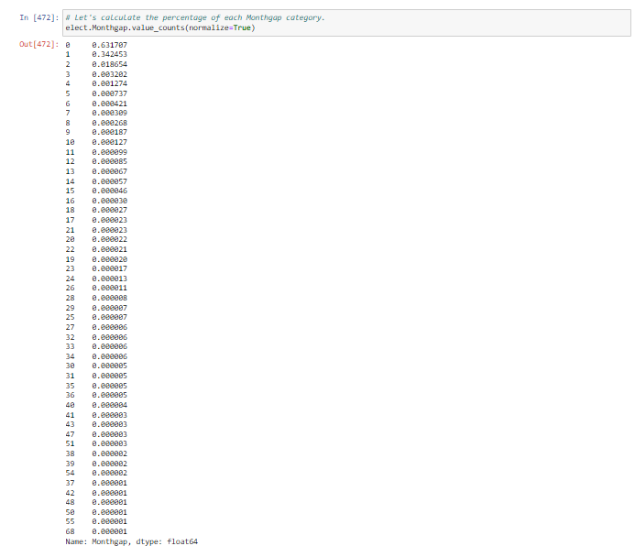
EDA

Slide 46
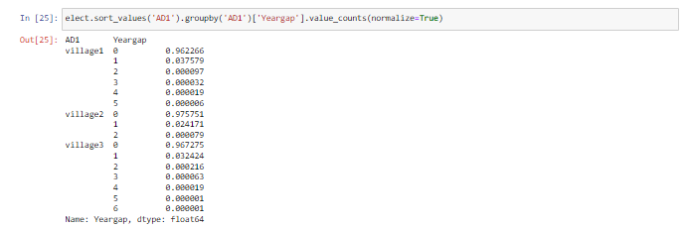
EDA

Slide 47
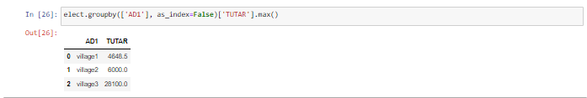
EDA

Slide 48
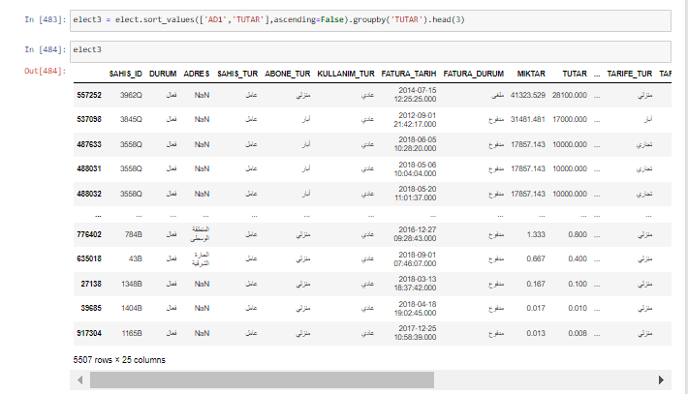
EDA

Slide 49
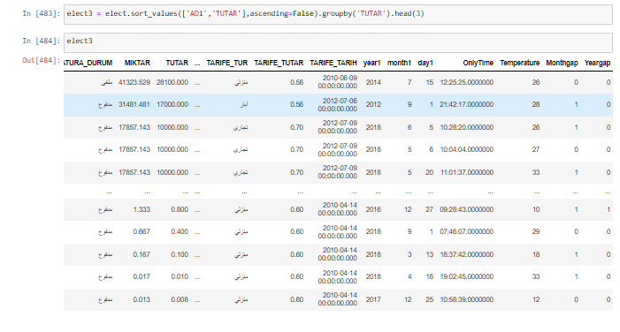
EDA

Slide 50
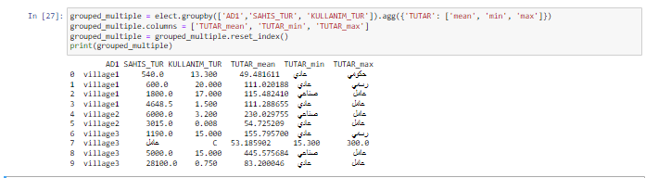
EDA

Slide 51



EDA

Slide 52

EDA

Slide 53

EDA

Slide 54

EDA

Slide 55

EDA

Slide 56

EDA

Slide 57

EDA

Slide 58

EDA
# START
fig = (data3['TUTAR'].loc[(data1['TUTAR'].index >= '2010-01-01') &
(data1['TUTAR'].index < "2018-12-31") &
(data1['AD1']== "village3") & (data1["TUTAR"] >5000)&(data1['SAHIS_TUR']== "عامل")& (data1['YER_TUR']== "شقة")& (data1['KULLANIM_TUR']== "عادي")] .plot(figsize = (15,10),title='Energy Consumption in Winter of 2013-14'))
plt.show()

Slide 59

EDA
#LARGE TUTAR LESS GAP
fig = (data3['TUTAR'].loc[(data1['TUTAR'].index >= '2010-01-01') &
(data1['TUTAR'].index < "2018-12-31") &
(data1['AD1']== "village3") & (data1["TUTAR"] >5000)& (data1["Monthgap"] <3)&(data1['SAHIS_TUR']== "عامل")& (data1['KULLANIM_TUR']== "عادي")] .plot(figsize = (15,10),title='Energy Consumption in Winter of 2013-14'))
plt.show()

Slide 60

EDA
#LARGE THAN AVERAGE 83
fig = (data3['TUTAR'].loc[(data1['TUTAR'].index >= '2010-01-01') &
(data1['TUTAR'].index < "2018-12-31") &
(data1['AD1']== "village3") & (data1["TUTAR"] >500)&(data1['SAHIS_TUR']== "عامل")& (data1['KULLANIM_TUR']== "عادي")] .plot(figsize = (15,10),title='Energy Consumption in Winter of 2013-14'))
plt.show()

Slide 61

EDA
#LESS AVERAGE
fig = (data3['TUTAR'].loc[(data1['TUTAR'].index >= '2010-01-01') &
(data1['TUTAR'].index < "2018-12-31") &
(data1['AD1']== "village3") & (data1["TUTAR"] <10)&(data1['SAHIS_TUR']== "عامل")& (data1['KULLANIM_TUR']== "عادي")] .plot(figsize = (15,10),title='Energy Consumption in Winter of 2013-14'))
plt.show()

Slide 62

EDA
#LESS TUTAR LARGE GAP
fig = (data3['TUTAR'].loc[(data1['TUTAR'].index >= '2010-01-01') &
(data1['TUTAR'].index < "2018-12-31") &
(data1['AD1']== "village3") & (data1["TUTAR"] <10)& (data1["Monthgap"] >1)&(data1['SAHIS_TUR']== "عامل")& (data1['KULLANIM_TUR']== "عادي")] .plot(figsize = (15,10),title='Energy Consumption in Winter of 2013-14'))
plt.show()

Slide 63
EDA
#LESS TUTAR LARGE GAP
fig = (data3['TUTAR'].loc[(data1['TUTAR'].index >= '2010-01-01') &
(data1['TUTAR'].index < "2018-12-31") &
(data1['AD1']== "village3") & (data1["TUTAR"] <10)& (data1["Monthgap"] >1)&(data1['SAHIS_TUR']== "عامل")& (data1['KULLANIM_TUR']== "عادي")] .plot(figsize = (15,10),title='Energy Consumption in Winter of 2013-14'))
plt.show()

Slide 64

EDA

Slide 65

EDA

Slide 66

EDA

Slide 67

EDA

Slide 68

EDA

Slide 69

EDA

Slide 70

EDA

Slide 71

EDA

Slide 72

EDA

Slide 73

EDA

Slide 74

EDA

Slide 75
THANK YOU

